Slide 1

L'Oréal Skincare Optimizer
Decoding Skincare Science with Sustainable AI
M2 Data Analytics for Business :
Ahmed DAMMAK
Aymane ACHARKI
Elizaveta BALAKIREVA
Obinna CHUKWU
Notes:
1

Slide 2

The "Analysis Paralysis" in Skincare
Modern skincare products are defined by complex chemical ingredients (Retinol, BHA, Peptides), not just vague categories like "for dry skin." This shift has left consumers feeling overwhelmed.
Ingredient Overload
Matching Mismatch
Confusing Marketing
70% of consumers feel overwhelmed by ingredient labels.
Struggling to match products to their specific biological needs.
Consumers seek dermatological precision but encounter ambiguous marketing.
Notes:
2

Slide 3














Our Solution: The Intelligent Optimizer
Introducing an AI inference engine that instantly parses product descriptions, translating complex chemistry into clear, actionable insights for consumers.
Oily
Acne
Core Value: Scientific Matching
Dry
Beyond simple search, our AI provides precise, science-backed product recommendations.
Sensitivity
Aging
Radiance
Notes:
3

Slide 4








Smarter, Not Harder (XGBoost)
Technical Architecture: Classifier Chains
We engineered an innovative solution using XGBoost wrapped in a Classifier Chain to leverage correlations between skin conditions, mimicking complex deep learning without the environmental cost.
XGBoost Foundation
Classifier Chain
Powerful, efficient gradient boosting framework.
Outputs of one classifier inform the next, capturing context.
Green AI Advantage
Correlated Logic
Achieves Transformer-like context with only 1% of the energy.
If "Oily Skin" is detected, it boosts the probability of "Acne" detection.
Notes:
7

Slide 5



Why We Rejected Deep Learning
Model Evolution: The Pivot to Green AI
Our journey involved exploring various models, ultimately prioritizing both accuracy and environmental responsibility.
Attempt 1: FastText
Too simplistic, missed nuanced correlations. Recall < 40%.
Attempt 2: BERT Transformers
Highly accurate, but incurred massive carbon footprint and slow inference (5s/product).
The Decision
Prioritizing sustainability: high accuracy without the GPU cost.
Notes:
6

Slide 6
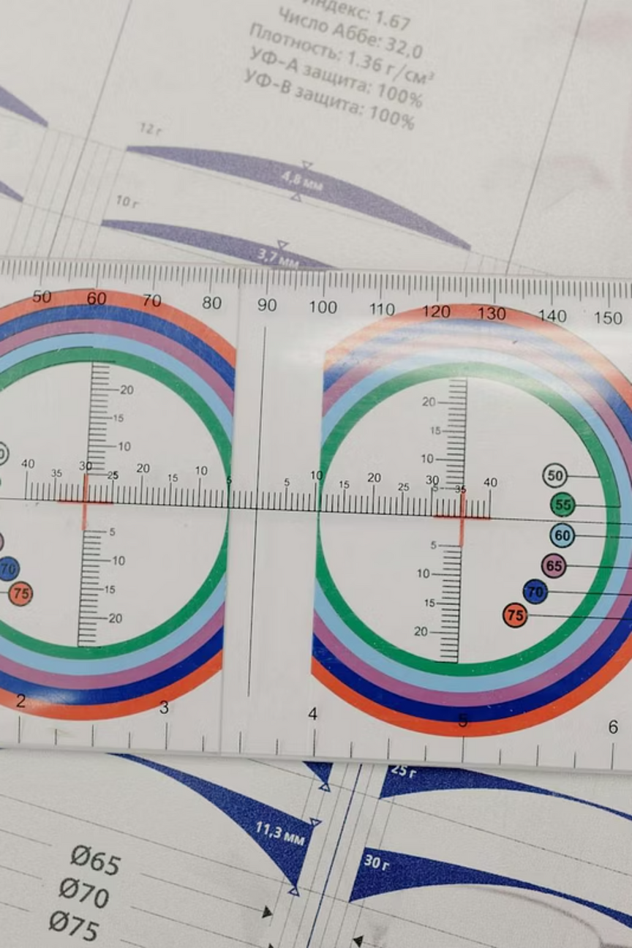




Engineering High-Quality Data
Our initial raw data was plagued with noise, including packaging sizes and irrelevant measurements, hindering model accuracy.
Eminence Cleanser 2 Oz Clear Skin Probiotic Masque (Acne Prone Skin) 2239 For Women Clear Skin Probiotic Masque (Acne Prone Skin) --60ml/2oz - 226601
The Challenge
Noisy data from product descriptions, including volume and weight units.
Regex Filters
Automated removal of all measurements and packaging terms.
↓
Normalization
NLTK Lemmatization to standardize variations (e.g., "hydrating" → "hydrate").
eminence cleanser clear skin probiotic masque acne prone skin 2239 for women 226601
60ml
Outcome
Reduced vocabulary size by 40%, focusing on meaningful terms.
Notes:
4

Slide 7
Strategies Considered But Not Implemented
Brand & ingredient extraction | no universal regex patterns found
Complete digit removal | lost critical information (SPF, concentrations)
Preserved meaningful punctuation (contractions) | reduced F1 score
Eliminated product codes with 3+ digits | reduced F1 score
Removed URLs, emails, phone numbers | reduced F1 score
Eliminated monetary expressions (currency + numbers) | reduced F1 score
Weighted label dictionaries. Example: "male": ["for men", "men's", "aftershave", "shaving", "beard"] | reduced F1 score

Slide 8
Final Model
XGBoost + Chain Classifier
GPU - RTX 4060 8 gb VRAM / CPU - AMD Ryzen 7840
Notes:
7

Slide 9
Model Workflow
Feature Engineering
Create features that give relevant informations for better predictions
Format, chemical composition, night/day
+91 Engineered Features
NLP
Lemmatizer + TF-IDF
+1800 TF-IDF Features
ML Model : XGBoost + ChainClassifier
Same F1 score as heavier and more complex models (SBERT, Deep Learning)
ChainClassifier to address multi-label dependencies, hyper-parameters optimization
Results Analysis
Metrics to assess
F1 Micro
Recall + Precision + Hamming Loss
CO2 emission + Models’ weight
Notes:
6

Slide 10
XGBoost - ChainClassifier
Parameters analysis
GPU : CUDA + Tree method : ‘hist’
n_estimators : 1900
Learning Rate : 0.008
dataset : 80% train - 10% test - 10% val
XGBoost
Chain Order : Higher confidence to lower, sequential order
Why : Enrich next predictions with less noise, implicit weights for no cost.
Personal vs Index based : ~0.15 F1 variation
ChainClassifier
Key advantages
Reduced complexity and computing cost vs Deep Learning or Stacking
Robust Multi-Label handling
Perfect Balance between Model weight / CO2 emissions / F1-Score
Notes:
6

Slide 11
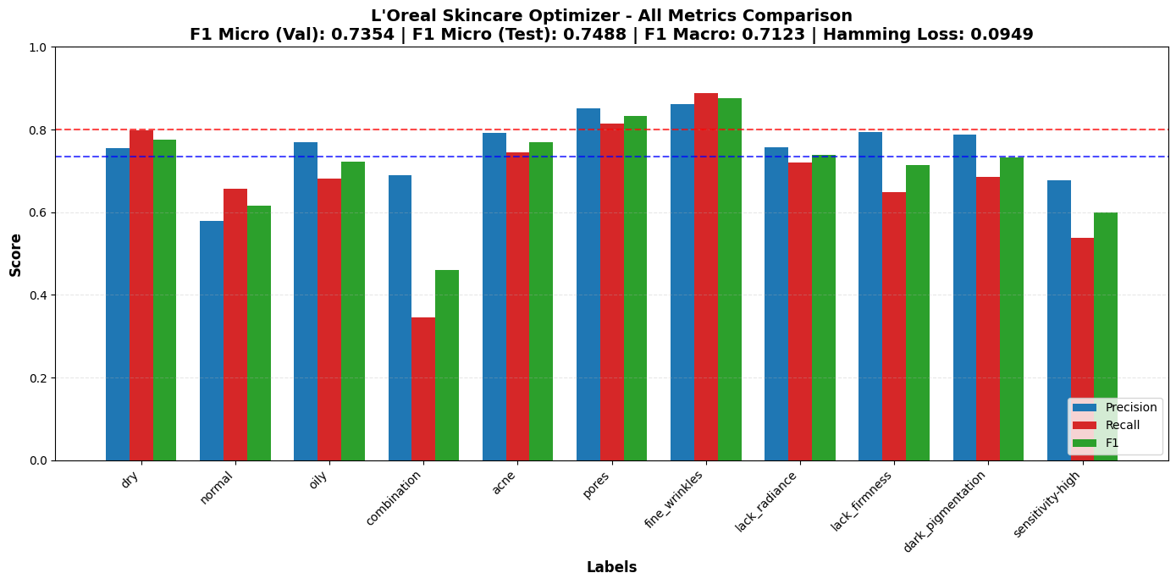
Final Results & Performance
Samples
Targets
Features
Energy
4136
11
1891
0.0021g

Slide 12

Model Analysis
F1 Micro
Over 100 labels, our model correctly predicts 75 of them
0.7488 (val 0.7354)
Over 100 products, our model recommends correctly 76 of them
Precision
0.7624
Out of 100 products that should help with a condition,
our model finds 68 of them
Recall
0.6762
Out of 11 possible skin concerns per product,
our model misclassifies ~1 label per product
Hamming
0.0949

Slide 13
Insights
Current limits
Road to improvement
Difficult Prioritizing
‘combination’ and ‘sensitivity-high’ have low recall for correct precision
Model struggles to find those labels but is relatively confident in its predictions
Higher quality feature engineering
Big challenge to choose between accuracy-wise model vs sustanability-wise
Apply more business rules based on relevant data
‘normal’ is the opposite, higher recall but poor precision
Model assigns the label incorrectly
Focus on hyper-parameter tuning
One model that can achieve best accuracy may be irrelevant given F1/CO2/Weight balance.
Breakdown into multi-class and label classification challenge
Notes:
2

Slide 14

Performance Model Comparison
Version
Architecture
Total size
F1-score
CO2 (g)
Total Score
V1
LogReg (40%) + SBERT (ext)
24.1 MB
0.7259
0.0481 g
0.47
V2
MiniLM-FT (92%)+ TF-IDF + XGBoost
93.6 MB
~0.74
~1.3 g
0.30
V3
TF-IDF + XGBoost (40%) + ChainClassifier
19.23 MB
0.7488
0.0021 g
0.91
Key Mentions
Scoring Formula
[0..1] Scale
Smallest size
Lowest CO₂
Total Score = (Size Efficiency × 0.33)
+ (F1 Score × 0.33) + (CO2 Efficiency × 0.33)
19.23 MB vs 93.6 MB (V2)
0.0021 g vs 1.3 g (V2)
-80% reduction
-99.8% reduction
Size Efficiency
Smaller model = Higher Score
F1 Score
Higher = Better Accuracy
Our model is accurate, lightweight and sustainable
CO2 Efficiency
Lower emissions = Higher Score

Slide 15

Impact on L'Oréal's Bottom Line
Business Impact & Scalability
Increased Conversion
Scalability
Reduces customer hesitation with instant "Scientific Validation" of product benefits.
Lightweight model can deploy in lower cost infrastructure while remaining accurate
Enhanced Trust
Transparency in AI results fosters deeper brand loyalty and customer confidence.
Notes:
9

Slide 16


Ready for the Real World
Live Demo & Future Roadmap
The L'Oréal Skincare Optimizer is fully functional and poised for immediate integration and future expansion.
Live Demo
Roadmap
Fully functional Streamlit Web App running today.
Phase 1: Deploy to Product Detail Pages (PDP).
Experience real-time product analysis and recommendations.
Phase 2: Integrate with L'Oréal's "Skin Genius" diagnostic tool.
"High Accuracy. Low Carbon. Better Skin."
Notes:
10

Slide 17

LIVE DEMO
Scan the QR code to try out
Click here!
paste this ...
“L'Oréal Paris Hydra Genius Daily Liquid Care. A lightweight moisturizer formulated with Aloe Water and 3 types of Hyaluronic Acid. Instantly refreshes and locks in moisture for 72 hours. Specifically designed for normal to dry skin to restore hydration and comfort”
Thank you...
Notes:
7

